Slide 1
第5-3章 MCMC
引言
Monte Carlo 近似计算
伪随机数生成
理论基础
MCMC算法
MCMC应用

Slide 2
Buffon投针实验(1777)
设针与平行线的夹角为φ，针的中点与最近的平行线的距离为X，相交条件为:
L
d
Notes:
Georges Louis Leclerc, Comte de Buffon, (1707-1788) French naturalist and mathematician best known as the creator of the immense Histoire naturelle. In mathematics he is still remembered for his work on probability and his famous needle prolem with which in 1777 he computed an approximation for π.
Question: What is the strips are distances a and b alternatively? Answer: [2L(a+b)-L*L](π a b)] ?

Slide 3
Buffon实验
学者 | 年代 | l/d | 总次数 | 成功 次数 | π 的 估计
Wolf | 1850 | 0.8 | 5000 | 2532 | 3.15956
Smith | 1855 | 0.6 | 3204 | 1218 | 3.1554
Fox | 1884 | 0.75 | 1030 | 489 | 3.1595
Lazzarini | 1907 | 0.833 | 3408 | 1808 | 3.14159292

Slide 4
Monte Carlo方法
Von Neumann
S.Ulam (1946)
N.Metropolis (1953)
Hasting (1970)
Monte Carlo (Monaco), famous for its gambling casino.

Slide 5
Monte Carlo 近似计算
例: 求 π 的近似值
考虑在单位方块上均匀分布的二元随机变量
如果生成一组样本
其落在单位圆内的频率v_{n}就是 的估计值

Slide 6
Monte Carlo 近似计算
利用 Chebechev 不等式, 立刻可以得到要保证误差不超过一个 给定值 ε 的概率小于 α , 应把 n 取多大

Slide 7
Monte Carlo 积分近似计算
Monte Carlo方法计算积分
随机抽取p(x)的样本
积分近似

Slide 8
收敛性与收敛速度
大数定理
当 时，

Slide 9
Confidence Interval
Sample variance
Convergence test
With which the confidence interval can be given

Slide 10
积分计算的统计意义
Bayesian分析中后验概率计算，通过极大后验概率进行分类
缺失数据(Missing data)中似然概率的计算

Slide 11
Importance Sampling
若 q(x)在p(x)非零点恒正，则
随机抽取q(x)的样本点

Slide 12
Importance Sampling
它是无偏估计
收敛条件

Slide 13
Choice of q(x)
方差
定理：当q(x)有如下表示时
上述方差最小

Slide 14
Choice of q(x)
证明：
第二项与q无关，而对第一项由Jensen不等式( 函数x² )，

Slide 15
Choice of q(x)
直接验证得：等号成立时q(x)

Slide 16
Monte Carlo 近似计算
但是上面的分布密度函数q(.)含未知数c, 其实它正是我们所要求的积分。所以上面的最优Importance Sampling方法并不可行。
利用 MCMC 算法可以不需要知道c的取值而得到分布密度函数近似为g(.)的样本。这样，我们就可以实现前面所讲的Monte Carlo的近似计算。

Slide 17
Pseudo-Random Numbers
Truly random numbers can not be generated on a computer
Pseudo-random numbers follows a well-defined algorithm, thus predictable and repeatable
Have nearly all the properties of true random numbers

Slide 18
Linear congruence generator (LCG)
One of the earliest and fastest algorithm:
where , M is the modulus, a is multiplier, c is increment. All of them are integers. Choice of a, c, M must be done with special care.
http://random.mat.sbg.ac.at/links/rando.html
Notes:
The following site points to many random number generators – theory and codes:
http://random.mat.sbg.ac.at/links/rando.html

Slide 19
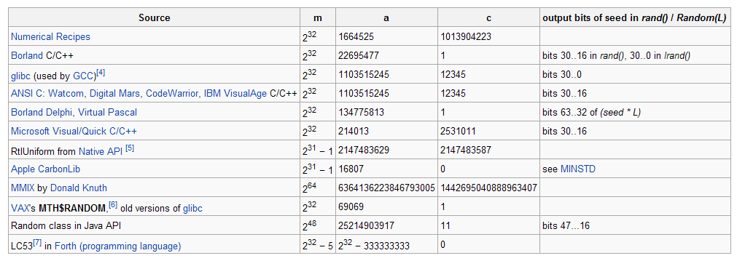
Choice of Parameters
http://en.wikipedia.org/wiki/Linear_congruential_generator
http://crypto.mat.sbg.ac.at/results/karl/server/server.html
Notes:
The site http://crypto.mat.sbg.ac.at/results/karl/server/server.html
has a comprehensive list of linear generators.

Slide 20
Other Modern Generators
Mersenne Twister (MT19937)
Extremely long period (2¹⁹⁹³⁷-1), fast
(http://www.math.keio.ac.jp/~matumoto/emt.html)
Inversive congruential generator
nonlinear, no lattice structure
http://en.wikipedia.org/wiki/Mersenne_twister
http://en.wikipedia.org/wiki/Inversive_congruential_generator
Notes:
The site http://www.math.keio.ac.jp/~matumoto/emt.html has source code in C and Fortran for the Mersenne Twister random number generator.

Slide 21
多项分布生成
设有多项分布
{ p₁ , p₂ , …, p_{n} },
要生成以它为分布的随机变量 ξ , 只要
将 [ 0 , 1 ] 区间分割为 n 份, 使得各份的长度分别为 p₁ , p₂ , …, p_{n}
生成随机变量 u, 使 U 遵从 [0,1]上均匀分布.
当 u 在上述区间的第 k 份， 取 ξ 为 k。

Slide 22
Non-Uniformly Distributed Random Numbers
Let F(x) be the cumulative distribution function of a random variable X, then x can be generated from
where ξ~U(0,1) , and F⁻¹(x) is the inverse function of F(x).

Slide 23
Proof the Inverse Method
The Mapping from x to ξ is one-to-one.
The probability for ξ between value ξ and dξ is 1·dξ, which is the same as the probability for x between value x and dx. Thus
Since F⁻¹ (ξ)=x, or ξ = F(x)

Slide 24
Example 1, Exponential Distribution
Density function,
Distribution function,
So we generate x by
Notes:
Why not x = -log(1-ξ)?

Slide 25
Example 2, Gaussian distribution
Take 2D Gaussian distribution
Work in polar coordinates,

Slide 26
Box-Muller Method
The formula implies that the variable θ is distributed uniformly between 0 and 2π, ½r² is exponentially distribution, we have
ξ1 and ξ2 are two independent, uniformly distributed random numbers.

Slide 27
Von Neuman 取舍原则
对于比较复杂的或不常见的分布, 下面的 Von Neuman 取舍原则 提供了一个非常有效的方法。
若密度为p₀(x)的随机变量容易生成，现在要生成密度为p(x)的随机变量，而且

Slide 28
Von Neuman 取舍原则
生成密度为p₀(x)的随机变量列
对 进行随机筛选, 留下的随机变量列就是密度为p(x)的随机变量列
筛选方法：独立生成U₁,…, U_{n}~U(0,1)，如果
删除 ，否则保留 .

Slide 29
Von Neuman 取舍原则的论证
留下的随机变量仍然是相互独立同分布的，它们中的每一个 ( 记为 η ) 的分布是

Slide 30
马氏链的遍历性与遍历极限
马氏链的遍历性定理：若有限状态Markov链的所有状态都是互通的(不可约)，f是状态空间上的有界实值函数且满足 则
其中π是MC的不变分布，而且此极限与初分布无关.

Slide 31
MCMC 算法的思想
对于非周期的MC (例如p_{ij}>0时)，我们还有
Markov Chain Monte Carlo 算法的思想就是：设计一个马氏链, 使得它的极限分布π与f成比例, 于是当我们模拟马氏链足够多步后, 它的分布就近似于π.

Slide 32
Markov Chain Monte Carlo
Goal: p(z^{(m)}) = p*(z) as m →∞
MCMCs that have this property are ergodic.
Transition properties that provide detailed balance guarantee ergodic MCMC processess.
Also considered reversible.

Slide 33
Markov Chain Monte Carlo (MCMC)
设计一个 Markov 链，使其不变分布为我们关心的分布, ( 如高维分布, 或样本空间非常大的离散分布)。用这个 Markov 链的样本, 来对该分布作采样, 并用以作随机模拟。这样的方法, 统称为Markov Chain Monte Carlo (MCMC)方法。
由于这种方法的问世, 使随机模拟在很多领域的计算中, 相对于决定性算法，显示出它的巨大的优越性。而有时随机模拟与决定性算法的结合使用, 会显出更多的长处.

Slide 34
MCMC 的应用
用于生成较复杂的随机数 ：高维分布的随机向量。
求复杂空间上函数的极值 ：模拟退火；
缺失数据的参数估计：Gibbs Sampler
Bayesian 缺失数据问题

Slide 35
Gibbs Sampler
生成一元随机变量是并不困难的， 但是生成高维各分量不独立的随机向量就非常困难。
Gibbs 采样法的思想是通过条件分布得到以给定分布π为不变分布的马氏链的转移概率.

Slide 36
Gibbs采样法
这里 是一个m-维分布密度,相应的马氏链的状态是m-维向量,其转移矩阵是 .具体地,取
意思是依次改变状态的m个分量,每次只改变状态的一个分量,使x变为y
容易验证： 即

Slide 37
Gibbs 采样法的论证

Slide 38
构造 Markov 链轨道的方法
从已有时刻 n 的样本 x_{n} 求时刻 n+1 的样本 x_{n+1}
先由 x_{n} =( x_{n}¹ , x_{n}² ,…, x_{n}^{s} ) 得到服从分布为
的一元随机变量 , 其中 x_{k}=x_{n}^{k}
用同样的方法，再得到服从分布
的样本 , 其中

Slide 39
构造 Markov 链轨道的方法
3. 依此下去…，得到 x_{n+1} 的所有分量.
4. 不断重复 1) － 3)， 我们就可以得到 上述马氏链的一 个样本轨道， 即一列随机向量 {x_{n} }, 其中 x_{n} 当 n 充分大时, 都可以近似地作为 p 的样本。

Slide 40
Metropolis Sampler
Metropolis-Hastings Algorithm
N. Metropolis, A.W. Rosenbluth, M.N. Rosenbluth, A.H. Teller and E.Teller. Equations of state calculations by fast computing machines. J.Chem.Phys.21: 1087-1091, 1953.
W.K. Hastings. Monte Carlo sampling methods using Markov chains and their applications. Biometrika. 57:97-109, 1970.

Slide 41
Metropolis 采样法概述 I
与Gibbs采样法一样，Metropolis方法也给出了在计算机上用 马氏链近似模拟遵从一个分布 π 的随机变量(向量) 的一个算法。
Metropolis 提出了这种采样法, 称为Metropolis采样法。

Slide 42
Metropolis 采样法概述 II
它与 Gibbs 采样法的不同处在于, 对于Metropolis采样法的转移概率如下：

Slide 43
Metropolis 采样法概述 III
其中 是一个对称的互通转移矩阵, 称为预选矩阵，使用它是为了减少状态间的连接, 以加快 Markov 链的分布向不变分布收敛的速度。
由于预选矩阵是一个对称的互通转移矩阵, 所以

Slide 44
Metropolis 采样法概述 IV
预选矩阵 的选取: 在许多情况下, 由于总的状态数非常多, 我们希望每次转移只能到达很少的几个状态, 但是保持不变分布仍然为 .
我们通常选取非常稀疏的预选矩阵, 只要保证它是互通而且对称的转移概率阵就行了.
例如当 π 为多维分布, 从一个状态 x 出发,可规定它只能到达与它只有一个分量不同的状态.

Slide 45
Metropolis-Hastings Algorithm
Set an initial value X₁.
If the chain is currently at X_{n} = x, randomly propose a new position X_{n+1} = y according to a proposal density q(x ,y).
Accept the proposed jump with probability
If not accepted, X_{n+1} = x.

Slide 46
Why M-H Works?
Transition probability
Detailed balance

Slide 47
Why M-H Works?
Case 1:
Case 2:
i.e.

Slide 48
Why M-H Works?
Case 3:
i.e.

Slide 49
MCMC应用于优化
模拟退火算法大意
部分Slides从下面的PPT中摘录
www.intelligentmodelling.org.uk/AB/G52AIM/G52AIM-Lecture03.ppt

Slide 50
优化问题
考虑最简单的单变量函数的最大值求解问题

Slide 51
Hill Climbing

Slide 52
The Problem with Hill Climbing
Gets stuck at local minima
Possible solutions
Try several runs, starting at different positions
Increase the size of the neighbourhood (e.g. in TSP try 3-opt rather than 2-opt)

Slide 53
Simulated Annealing
Motivated by the physical annealing process
Material is heated and slowly cooled into a uniform structure
Simulated annealing mimics this process
The first SA algorithm was developed in 1953 (Metropolis)
Metropolis, N., Rosenbluth, A.W., Rosenbluth, M.N., Teller, A.H. and Teller, E. Equations of State Calculations by Fast Computing Machines. Journal of Chemical Physics, 21(6):1087-1092, 1953.

Slide 54
Simulated Annealing
Compared to hill climbing the main difference is that SA allows downwards steps
Simulated annealing also differs from hill climbing in that a move is selected at random and then decides whether to accept it
In SA better moves are always accepted. worse moves are not

Slide 55
Simulated Annealing
Kirkpatrick (1982) applied SA to optimization problems
Kirkpatrick, S , Gelatt, C.D., Vecchi, M.P. 1983. Optimization by Simulated Annealing. Science, vol 220, No. 4598, pp 671-680

Slide 56
概率观点处理优化问题
若x₀是最大值，那么考虑非负函数
由热力学定律，有Boltzman分布
温度趋于无穷时，分布趋于均匀分布
温度趋于0是，分布趋于单点分布

Slide 57
模拟退火
实质就是要构造适当的Markov链，使得相应Boltznann分布作为其极限分布
温度T有一个调整的过程，首先升温保证初始点几乎以均一的概率都能被访问到，而后逐渐降温，使得分布越来越集中到最大值点

Slide 58
转移概率构造 (Metropolis-Hastings Algorithm)
对应同一个温度下，考虑x到 y的移动,
或者只允许x到其近邻的移动，

Slide 59
To accept or not to accept?
The law of thermodynamics states that at temperature, t, the probability of an increase in energy of magnitude, , is given by
Where k is a constant known as Boltzmann’s constant

Slide 60
To accept or not to accept - SA?
where
c is change in the evaluation function
t the current temperature
r is a random number between 0 and 1

Slide 61
To accept or not to accept - SA?
The probability of accepting a worse state is a function of both the temperature of the system and the change in the cost function
As the temperature decreases, the probability of accepting worse moves decreases
If t=0, no worse moves are accepted (i.e. hill climbing)

Slide 62
SA Cooling Schedule
Starting Temperature
Final Temperature
Temperature Decrement
Iterations at each temperature

Slide 63
Starting Temperature
Must be hot enough to allow moves to almost neighbourhood state (else we are in danger of implementing hill climbing)
Must not be so hot that we conduct a random search for a period of time
Problem is finding a suitable starting temperature

Slide 64
Choosing Starting Temperature
If we know the maximum change in the cost function we can use this to estimate
Start high, reduce quickly until about 60% of worse moves are accepted. Use this as the starting temperature
Heat rapidly until a certain percentage are accepted the start cooling

Slide 65
Choosing Final Temperature
It is usual to let the temperature decrease until it reaches zero. However, this can make the algorithm run for a lot longer, especially when a geometric cooling schedule is being used
In practice, it is not necessary to let the temperature reach zero because the chances of accepting a worse move are almost the same as the temperature being equal to zero

Slide 66
Choosing Final Temperature
Therefore, the stopping criteria can either be a suitably low temperature or when the system is “frozen” at the current temperature (i.e. no better or worse moves are being accepted)

Slide 67
Temperature Decrement
Theory states that we should allow enough iterations at each temperature so that the system stabilizes at that temperature
Unfortunately, theory also states that the number of iterations at each temperature to achieve this might be exponential to the problem size

Slide 68
Temperature Decrement
We need to compromise
We can either do this by doing a large number of iterations at a few temperatures, a small number of iterations at many temperatures or a balance between the two

Slide 69
Temperature Decrement
Linear
Geometric
Experience has shown that α should be between 0.8 and 0.99, with better results being found in the higher end of the range. Of course, the higher the value of α, the longer it will take to decrement the temperature to the stopping criterion

Slide 70
Iterations at each temperature
A constant number of iterations at each temperature
Another method, first suggested by (Lundy, 1986) is to only do one iteration at each temperature, but to decrease the temperature very slowly.

Slide 71
Iterations at each temperature
An alternative is to dynamically change the number of iterations as the algorithm progresses
At lower temperatures it is important that a large number of iterations are done so that the local optimum can be fully explored
At higher temperatures, the number of iterations can be less

Slide 72
MCMC for Parameters Estimation with Missing Data

Slide 73
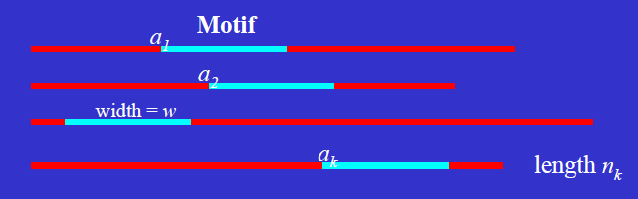
Motif Finding Problem
Object: finding the best “common” pattern
Missing data: alignment variable

Slide 74
Motif Finding Problem
Alignment variable:
Parameters:

Slide 75
Gibbs Sampler
Iterative sampling
Draw from
Draw from

Slide 76
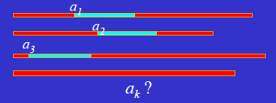
Implementation: Predictive Updating
Pretend k-1 sequences are aligned
Predict the kth sequence (stochastically)

Slide 77
Predictive Updating
Compute predictive frequencies of each position i in motif
Counts of nucleotide type j at position i.
Count of nucleotide type j at non-site position.
Sample from the predictive distribution of

Slide 78
Gibbs Sampler Algorithm
Initialize by choosing random starting positions
Iterate the following steps many times:
Randomly or systematically choose a sequence, say sequence k, to exclude.
Carry out Predictive Update step to update
Stop when changes are small, or other convergence criterion met.

Slide 79
MCMC for Bayesian Missing Data Problem

Slide 80
Bayesian Inference
Now the parameter is also a random variable, with a prior probability
Using Bayes rule, the posterior probability
Posterior ∝ “Likelihood” × Prior

Slide 81
Conjugate Prior
The posterior distribution is in the same family as the prior distribution
采用共轭先验的原因是为了简化积分计算
http://en.wikipedia.org/wiki/Conjugate_prior

Slide 82
Conjugate Prior
Example: n次独立实验，每次实验成功的概率为p, 总成功次数X服从二项分布，共轭先验Beta分布

Slide 83
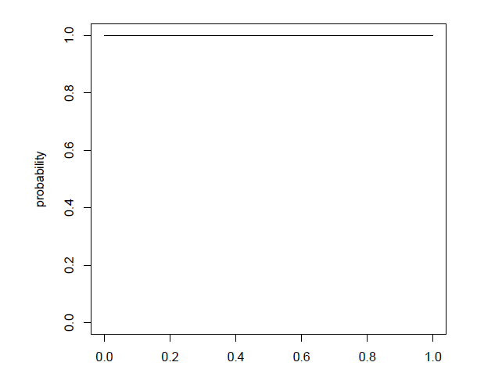
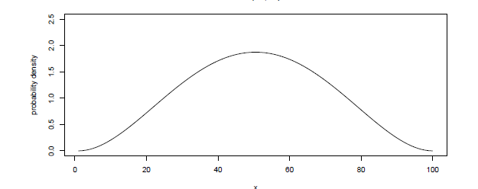
Conjugate Prior
Beta(1,1) Beta(3,3)

Slide 84
Conjugate Prior
Normal distribution with known variance
Normal prior distribution
Posterior distribution

Slide 85
MCMC for Bayesian Inference
Draw samples from the posterior distribution
Use these samples to compute some objectives.

Slide 86
Prediction
Given data D, compute probability for
Predictive Distribution

Slide 87
Back to Motif Finding Problem
Given K sequences, each containing exact one motif (width w)
Alignment variable is missing
Product multinomial model
Background Model：
Motif Model：
Prior:

Slide 88
Gibbs Sampler
Iterating
Drawing from
Drawing A from
Such a procedure constructs a Markov chain whose equilibrium distribution is

Slide 89
Collapse Gibbs Sampler
One can integrate out parameters
Directly sample A.
Lawrence, Liu, Neuwald, Collapsed Gibbs Sampler algorithm in Multiple Sequence Alignment. 1993,1994,1995

Slide 90
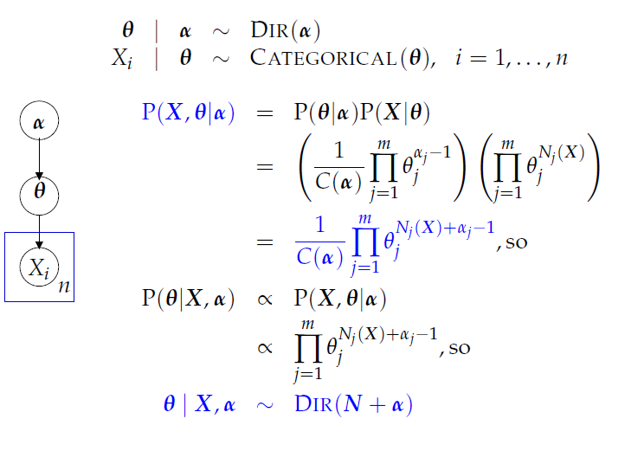
Dirichilet-Multinomial distribution

Slide 91
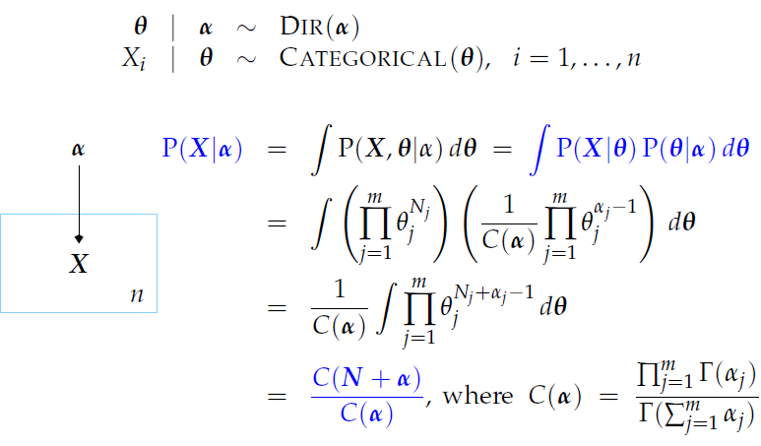
Collapse Model

Slide 92
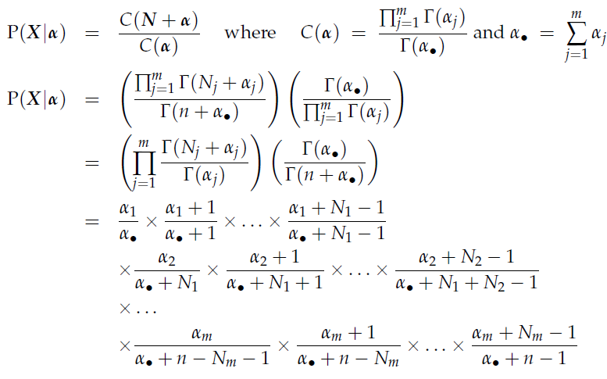
Dirichilet-Multinomial Posterior

Slide 93
Original Gibbs Sampler algorithm
Step0. choose an arbitrary starting point
A₀=(a_{1,0},a_{2,0},…,a_{N,0},Q₀);
Step2. Generate A_{t+1}=(a_{1,t+1},a_{2,t+1},…,a_{N,t+1},Q_{t+1}) as follows:
Generate a_{1,t+1}~π(a₁┃ a_{2,t},…,a_{N,t} , Q_{t}, B);
Generate a_{2,t+1}~π(a₂┃ a_{1,t+1}, a_{3,t} …,a_{N,t} , Q_{t}, B);
…
Generate a_{N,t+1}~π(a_{N}┃ a_{1,t+1}, a_{2,t+1} …,a_{N-1,t+1}, Q_{t}, B);
Generate Q_{t+1}~π(a_{N}┃ a_{1,t+1}, a_{2,t+1} …,a_{N,t+1}, B);
Step3. Set t=t+1, and go to step 1

Slide 94
Collapsed Gibbs Sampler
Step0. choose an arbitrary starting point
A₀=(a_{1,0},a_{2,0},…,a_{N,0});
Step2. Generate A_{t+1}=(a_{1,t+1},a_{2,t+1},…,a_{N,t+1} ) as follows:
Generate a_{1,t+1}~ π(a₁┃ a_{2,t},…,a_{N,t} , B);
Generate a_{2,t+1}~ π(a₂┃ a_{1,t+1}, a_{3,t} …,a_{N,t} , B);
…
Generate a_{N,t+1}~ π(a_{N}┃ a_{1,t+1}, a_{2,t+1} …,a_{N-1,t+1}, B);
Generate Q_{t+1} ~ π(Q┃ a_{1,t+1}, a_{2,t+1} …,a_{N,t+1}, B);
Step3. Set t=t+1, and go to step 1

Slide 95
References
Jun S. Liu. Monte Carlo Strategies in Scientific Computing. (2001). Springer.
Christian P. Robert and George Casella. Monte Carlo Statistical Methods. Second Edition. (2004). Springer.

